Slide 1
STEMI
Initial Therapy: MONA
Morphine: 2-4 mg IV repeat q10 min
Oxygen if SaO2 < 90%
Nitroglycerin: 0.4 mg sublingual & Nitrate IV to 10 mcg/min
Aspirin: 162-325 mg chewed (2-4 tablets)
IV Metoprolol
Reperfusion Therapy
Continue Heparin
If:
Symptom onset < 12 hr
2 contiguous ST elevations
And can start within 30 min
If:
Symptom onset < 12 hr
Start within 90 min
PCI + UFH + GP2a/3b
UFH
1. UFH 60 Units/kg IV bolus then
2. UFH 12 Units/kg/hr IV infusion
+
GP Iib/IIIa. Start at the same time as PCI
+
Primary PCI (preferred) aka Balloon time
d/c UFH right after PCI
d/c GP Iib/IIIa 12-24 hours after PCI
Fibrinolytic Therapy + Anticoagulant
Fibrinolytic Therapy (Alteplase)
1. Alteplase 15 mg bolus then
2. Alteplase 0.75 mg/kg infusion for 30 min (max 50 mg)
3. Alteplase 0.5 mg/kg infusion for 1 hour (max 35 mg
+
Anticoagulant
Enoxaparin: 30 mg IV bolus
followed immediately by
Enoxaparin1 mg/kg subQ q12h for the duration of hospitalization
Secondary Prevention
1. Continue Aspirin 81 mg (indefinitely)
2. Clopidogrel 75 mg PO daily
3. Beta-blocker (indefinitely)
4. Statin (indefinitely)
5. Continue Nitroglycerin 0.4 SL prn
6. ACE-I or ARB
Aldosterone antagonist if on ACE-I + LVEF < 40% + symptoms
Notes:
For the fibrinolytic therapy (in orange). The Enoxaparin can change, depending on the patient (described on slide 4)
If CrCl > 30 then:
30 mg IV bolus then 1mg/kg SQ q12h for the duration of hospitalization
If CrCl < 30 then:
30 mg IV bolus then 1mg/kg SQ q24h for the duration of hospitalization
If Age > 75 thhen
No IV bolus. 0.75 mg/kg SQ q12hr

Slide 2
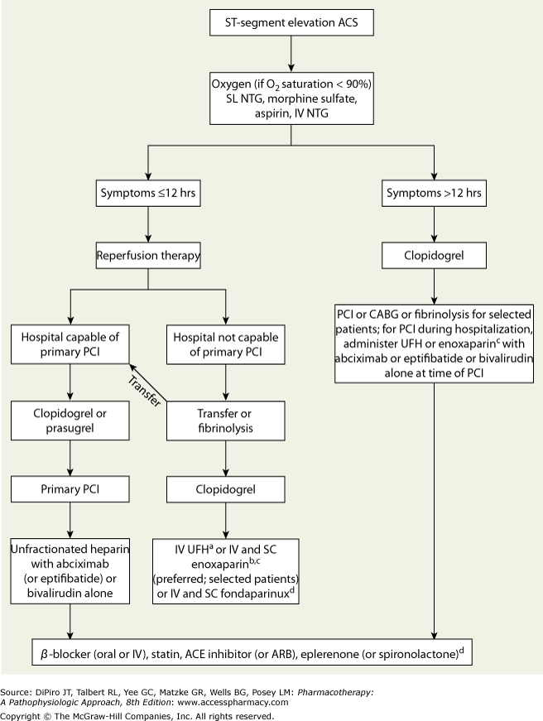
Notes:
DVT 80/18
Fibrinolytic 60/15
PCI 50

Slide 3
Initial Therapy: MONA
Morphine
Oxygen
Nitroglycerin SL
Aspirin:
Metoprolol
Order | Drug | Dose | Note
1st | ASA | 162 mg chewed | Do not use enteric coat (want fast onset)
2nd | Nitroglycerin SL | 0.4 mg SL q5min 3x doses | Use IV if no relief
3rd | Morphine | 2 mg IV q10 min prn chest pain | Use if continued chest pain
4th | Metoprolol Tartrate | 5 mg slow IV push (over 1-2 min) q5min x 3 then 25 – 50 mg PO q6hrs | Make sure pt has no signs of HF b/c it’ll make them feel worse
5th | UFH | 5000 Units SQ q8-12h | Get ready for reperfusion
6th | Clopidogrel | 600 mg loading dose If patient is < 75 y/o, then 300 mg

Slide 4
When to use UFH Vs Enoxaparin
Fibrinolytic + Anticoagulant at the same time
Below are the anticoagulants you can use during fibrinolytic
Use for duration of hospitalization
If pt is in hospital for > 48 hr
Enoxaparin (DOC for fibrinolytic)
If CrCl < 30
UFH
Drugs | Dose of anticoagulants | If CrCl < 30 ml/min | Extra notes
UFH 60/12 4000/1000 | 60 units/kg IV bolus (max 4000 Units) followed by 12 units/kg/hr (max 1000 Units/hr) | No need for renal clearance | Chance of HIT Adjusted to maintain aPTT 1.5 - 2 X control
Enoxaparin (Lovenox®) *preferred | 30 mg IV bolus followed immediately by 1 mg/kg subQ q12h | Renally cleared 1 mg/kg subQ q24h | If age > 75 years: eliminate bolus and dose 0.75 mg/kg subQ q12h
Fondaparinux (Arixtra®) | 2.5 mg IV, followed by 2.5 mg subQ daily No chance for HIT | Contraindicated if CrCl < 30 ml/min | No chance for HIT Goal: aPTT 1.5 – 2x control

Slide 5
Fibrinolytic Therapy (Alteplase)
Within 30 min of hospital presentation
Drug | Fibrin Specificity | Dosage
Streptokinase | + | 1.5 million units in 50 mL infused over 60 min
Reteplase (rPA) Retavase | ++ | 10 units IV push over 2 min 30 min later… another 10 units IV push
Alteplase (tPA) Activase | +++ | Step 1: 15 mg bolus followed by Step 2: 0.75 mg/kg (max 50 mg) infusion over 30 min Step 3: followed by 0.5 mg/kg (max 35 mg) over 1 hr
Tenecteplase (TNK-tPA) TNKase | ++++ | < 60 kg = 30 mg IV bolus 60–69.9 kg = 35 mg IV bolus 70-79.9 kg = 40mg IV bolus
Monitor:
S/S of bleeding
mental status – blood might be in dome piece
Hg/Hct – might be high on 1st day b/c patient is dehydrated
NO SrCr
Notes:
Max weight is 150 lb or 67 kg
Know heparin dosing
Know heparin max dose
Know enoxaparin is renally cleared
Know Fondaparinux is contraindicated if CrCl is renally cleared and is ok for pts with HIT
If MI w/o fibrinolytic → 80/18
If MI with fibrinolytic → 60/12

Slide 6
Fibrinolytic Therapy (Alteplase)
Within 30 min of hospital presentation
Goal: reopen coronary artery
Can give fibrinolytic if all 4 is met...
STEMI (do not give if NSTEMI)
Symptoms within 12 hours
2 back to back ST elevations
Door to Needle Time: patient must be given fibrinolytic within 30 min of presentation
Absolute Contraindications
Previous intracranial hemorrhage
Ischemia stroke within 3 months
Known intracranial neoplasm or structural lesion
Close head or facial trauma within 3 months
Active internal bleeding
Suspected aortic dissection
Relative Contraindications
Uncontrolled HTN > 180/110
Hx of stroke > 3 months
Internal bleeding within 1 month
CPR within 3 weeks
pregnant
Side Effects
#1. Intracranial hemorrhage (ICH)

Slide 7
Primary PCI (preferred) aka Balloon time
Within 90 min of hospital presentation
Deciding to do PCI
Patient has No HIT
Patient has HIT
Right before PCI
UFH + GP IIb/IIIa
GPIIb/IIIa
Abciximab
No renal
Or
Tirofiban
0.4 mcg/kg bolus then
0.1 mcg/kg/min
½ infusion dose if CrCl < 30 to 0.5 mcg/kg/min
Or
Eptifibatide
180 mcg/kg IV bolus x2 then
2 mcg/kg/min
½ infusion dose if CrCl < 50 to 1 mcg/kg/min
UFH
60 units/kg IV bolus (max 4000 Units)
followed by
12 units/kg/hr (max 1000 Units/hr)
+
Bivalirudin
Or
Argatroban
PCI
d/c GPIIb/IIIa 24hr after PCI
d/c UFH right after PCI
Notes:
Know UFH dosing
It’s also the same dosing for fibrinolytic therapy

Slide 8
Secondary Prevention
Loading dose: 162 mg
Maintenance: 81 mg PO daily
forever
Monitor:
Bleeding
GI
Hg/Hct
1. ASA
Loading dose: 600 mg
Maintenance 75 mg PO
Minimum of 12 months
Monitor
Bleeding
Ischemia
Hg/Hct
2. Clopidogrel
3. Nitrates
0.4 mg SL q5min
Start IV
Titrate IV until ischemia is relieved
Continue for 24 hours
Everyone
Metoprolol Tartrate
25 mg PO BID
Or
Carvedilol
3.125 mg PO BID
4. Beta Blocker
Goal: HR 50-60
5. ACE-I
Shitopril
6. Statin
Atorva (Lipitor) 80 mg
Goal < 70
Notes:
Metoprolol
Acute enter hospital: 5 mg slow IV push (over 1-2 min) q 5 min x 3, then 25 – 50 mg po q6hrs
Secondary prevention: 25 – 100 mg po BID
Titrate by doubling dose (25 → 50 → 100)
Blood glucose < 180

Slide 9
NSTEMI
Past Medical History |  | Clinical Presentation
Age > 65 years | (1) | ST-segment depression | (1)
≥ 3 Risk Factors for CAD: Hypercholesterolemia HTN Diabetes Smoking Family hx of premature CHD | (1) | ≥ 2 episodes of chest discomfort in past 24 hrs | (1)
 |  | Positive biochemical marker (troponin, CK-MB) | (1)
Known CAD (≥ 50% stenosis of coronary artery) | (1)
Use of ASA in last 7 days | (1)
Low Risk | Medium Risk | High Risk
0 -2 points | 3 - 4 points | 5 -7 points

